Slide 1
2025 NFHS Music Points of Emphasis
Amy Perras – NFHS Music Advisory Committee Chair
Chris Paulson – NFHS Director of Performing Arts

Slide 2
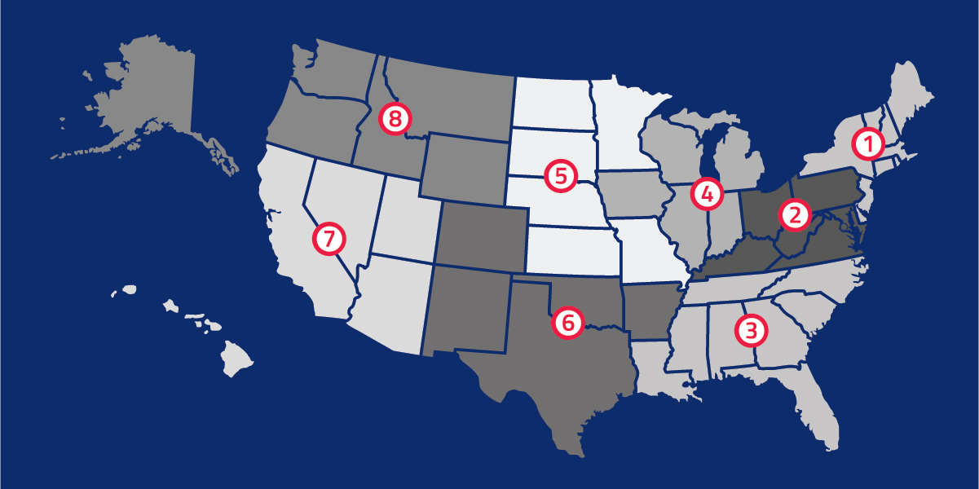

National Federation of State High School Associations
located in Indianapolis, IN – Est. 1920
National leader and advocate for high school athletics and performing arts programs.
Serves 51 state associations, 19,500 high schools, and 12 million student participants.
Offers online education courses for high school coaches, officials, parents, students and others.
Ensures that students have opportunity to enjoy healthy participation, achievement and good sportsmanship in education-based activity programs.

Slide 3
NFHS Music Committee
Chair
Amy Perras
Connecticut
Staff Liaison
Chris Paulson
NFHS
Editor
Tim Leighton
NFHS Journal
Section 1
David Brown
New York
Section 2
John Stroube
Kentucky
Section 3
Kathleen Sanz
Florida
Section 4
Laurie Fellenz
Wisconsin
Section 5
Taryn Retzlaff
Nebraska
Section 6
Zac Stevenson
New Mexico
Section 7
Justin Bills
Utah
Section 8
Brent Rose
Wyoming
At Large
Shelly Bauer
New York
At Large
Brandon DuVall
Ohio
At Large
Guillermo Rodriguez
Kansas

Slide 4
2025 Points of Emphasis Workforce Development
To meet the evolving needs of students who are pursuing careers in music education, performance, and industry, schools must develop robust Career and Technical Education (CTE)-aligned pathways that reflect the realities of today’s music professions. By equipping music educators with appropriate certifications and advocating for performance-based credentials, districts can expand access to industry-relevant instruction and funding. These efforts will empower students to graduate with marketable skills in multiple areas, while reinforcing the value of performing arts in workforce development.

Slide 5
2025 Points of Emphasis Health and Safety 1. Repetitive Strain Injuries
Musicians engaged in regular, repetitive, and/or sustained use of specific muscle groups through participation in instrumental or vocal music are at risk of developing repetitive strain injuries. State associations and schools should take a proactive approach to ensure that injury risk is minimized during participation in music.
2. Event Safety: Annual Review of Emergency Action Plans
Emergencies can happen anytime, anywhere, and schools must be prepared to respond effectively. A well-developed Emergency Action Plan (EAP), including venue-specific details, thorough communication strategies, considerations for the special needs of individuals with disabilities, and strategies to rehearse and implement that plan, will minimize risk and promote a safe environment for all.

Slide 6
2025 Points of Emphasis Health and Safety 3. Climate-Related Concerns
An effort to provide rehearsal and performance venues for performing arts activities that mitigate risk from climate-related issues should be considered. These may include but are not limited to extreme temperature ranges (both hot and cold), high winds, potential for flooding, air quality and/or pollutants, and other localized severe weather events. Utilizing appropriate monitoring systems and establishing data-driven action protocols are necessary to ensure the safety of all performing arts participants and spectators.

Slide 7
2025 Points of Emphasis Access
The NFHS believes every student should have meaningful opportunities to participate in the performing arts. Educators are encouraged to provide appropriate access to resources such as supplies, instruments, and attire, and to support students who might face challenges in connecting to the academic framework.
Students should be evaluated based on the quality of their performance and artistic expression, rather than differences in resource availability. Adjudication and instruction must focus on learning, growth, and achievement for all participants.

Slide 8
2025 Points of Emphasis Artificial Intelligence
As artificial intelligence continues to evolve, music educators, coaches and directors are encouraged to establish policies and procedures that support the responsible use of AI, promoting transparency and trust. It is essential to balance the opportunities AI offers, such as creative exploration, collaboration and innovation, with the preservation of the student’s individual voice and artistic integrity. While AI may enhance learning and performance experiences, all participants should remain mindful of the ethical boundaries and professional responsibilities associated with this technology.

Slide 9
2025 Points of Emphasis NFHS Learn
The NFHS Learn platform provides many free essential, research-based training modules that support safe, effective and well-managed music programs. Specifically, courses covering Vocal Health, Heat Illness Prevention and Music Adjudication are examples of valuable training that music educators are encouraged to explore. By using NFHS Learn, the performing arts community can grow its collective knowledge, prioritize safety and provide the highest level of support for all participants.
https://www.nfhslearn.com

Slide 10
Thank you!
www.nfhs.org PO Box 690 | Indianapolis, IN 46206 artsadvocacy.nfhs.org

